Slide 1
Startup Publisher
Veeraj Jadeja
John McGee
Kieran Buckley
Hardik Patel

Slide 2
Background
We are a startup publisher conducting preliminary research.
Public Library Systems in America as a whole account for one of the largest exchanges of published material in the world
The Seattle Public Library System is the 17th most visited in the US (excluding University Libraries) with over 5.4 million visits per year¹ and possess a collection of over 2.3 million items².
Serves a population of approximately 686,800, with over 378,000 members².

Slide 3
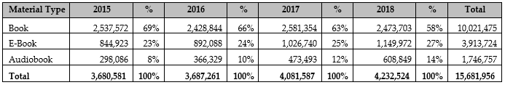
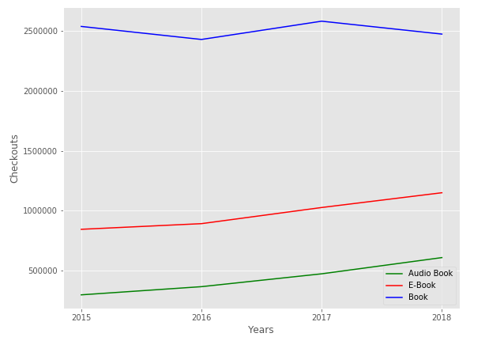
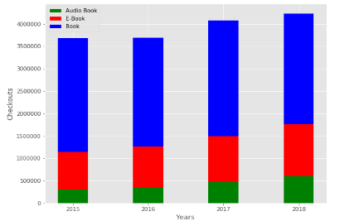
In what format are people consuming material and how is it changing over time?
Checkouts By Material Type and Year

Slide 4
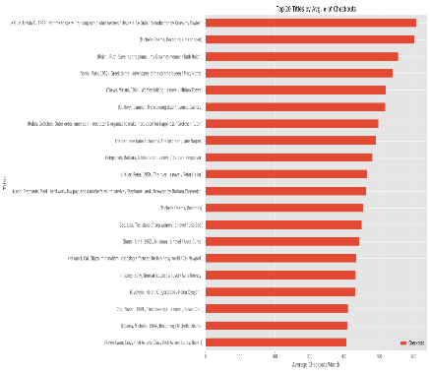
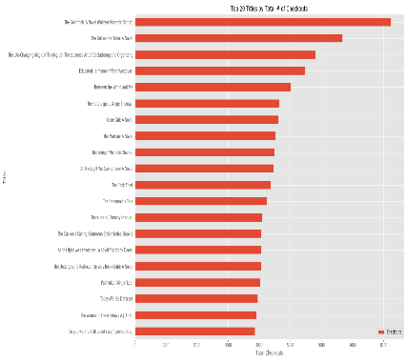
What are the Most Popular and Top Checked out Titles?

Slide 5
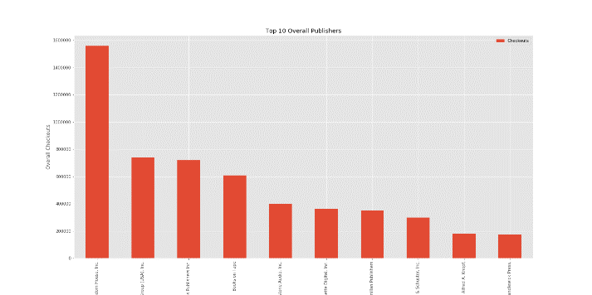
Who are the top 10 publishers?

Slide 6
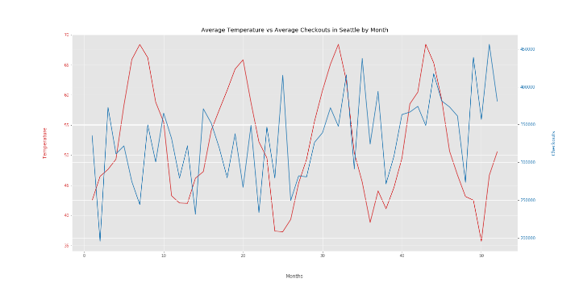
Is there a correlation between weather and checkouts?

Slide 7
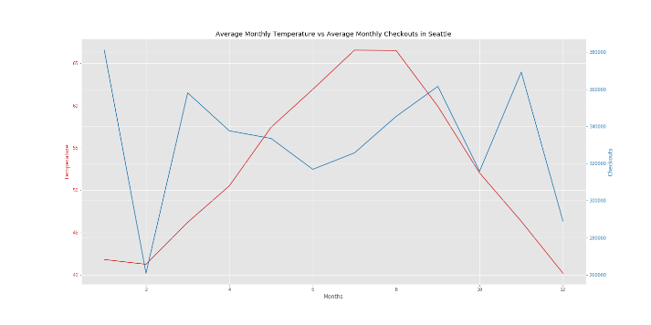
Is there a correlation between weather and checkouts?

Slide 8
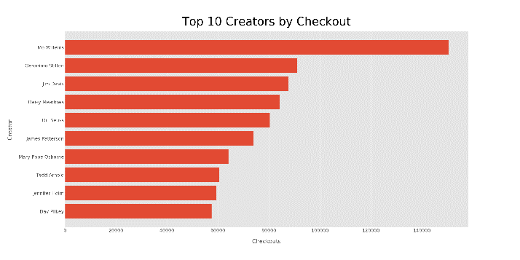
Top 10 Creator by Checkout

Slide 9
Data Limitations
Book sales data is actually extremely difficult to come by
Amazon only publicly tracks last 4 weeks and shuts down people who try to use it's API for tracking purposes
Major players are NPD which offer paid enterprise level solutions (industry research) and various top 10 lists that are usually weekly/monthly (New York TImes/PublishersWeekly)
Startup publisher would probably want to first stitch together public (and free) datasets to try to make predictions instead of immediately blowing $$$$ on expensive alternatives

Slide 10
References
"2016 Washington Public Library Statistical Report" (PDF). Washington State Library. October 2017. Retrieved 05, July 2019.
“Seatle Public Library.” Wikipedia: The Free Encyclopedia. Wikipedia, The Free Encyclopedia, 11, June 2019. Web. 05, July 2019,https://en.wikipedia.org/wiki/Seattle_Public_Library
Open Weather, https://openweathermap.org/

